Slide 1

Web Scraping Project National Park
Hsiang-Yuan(Joshua) Lee

Slide 2
Question
What is the good time to visit National Parks?
Which National Parks Campground is popular?

Slide 3
Website
https://en.wikipedia.org/wiki/
https://www.recreation.gov/
https://www.tripadvisor.com/
https://irma.nps.gov

Slide 4
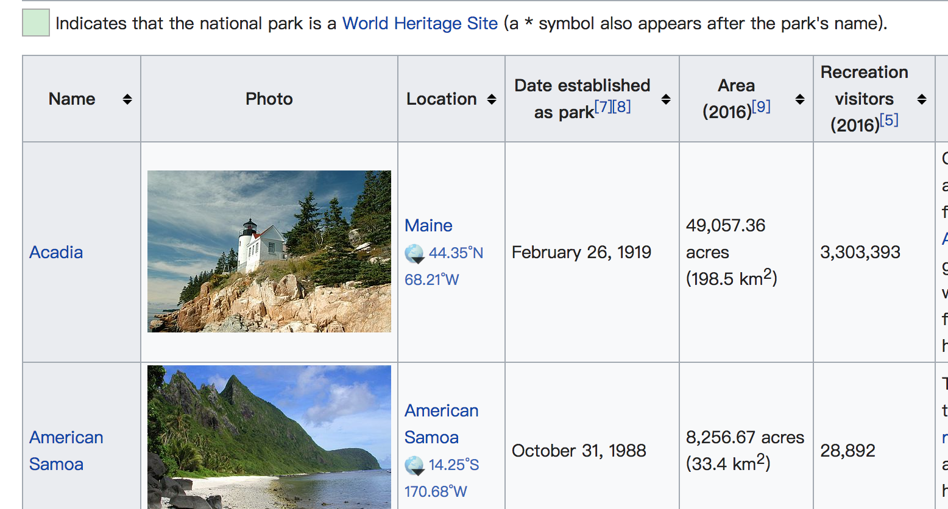
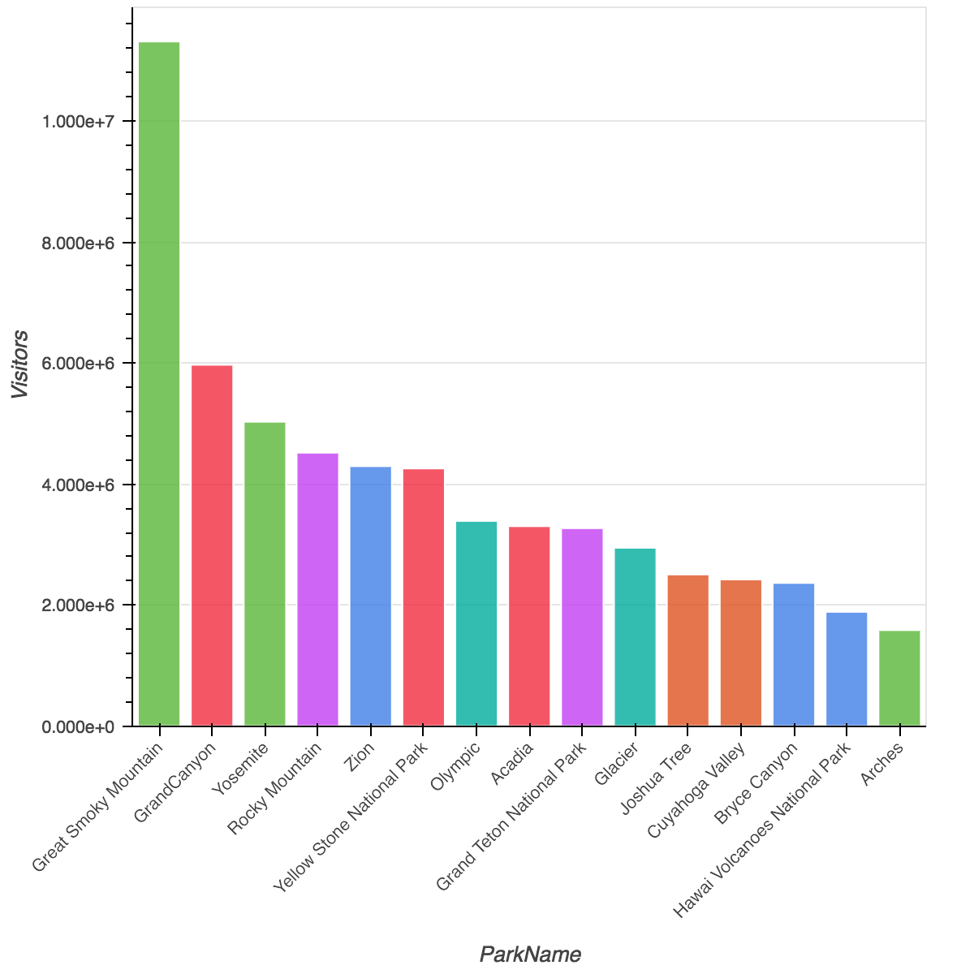
Visitors in each National Parks
Obviously, The Great Smoky Mountain has the highest Visitors

Slide 5
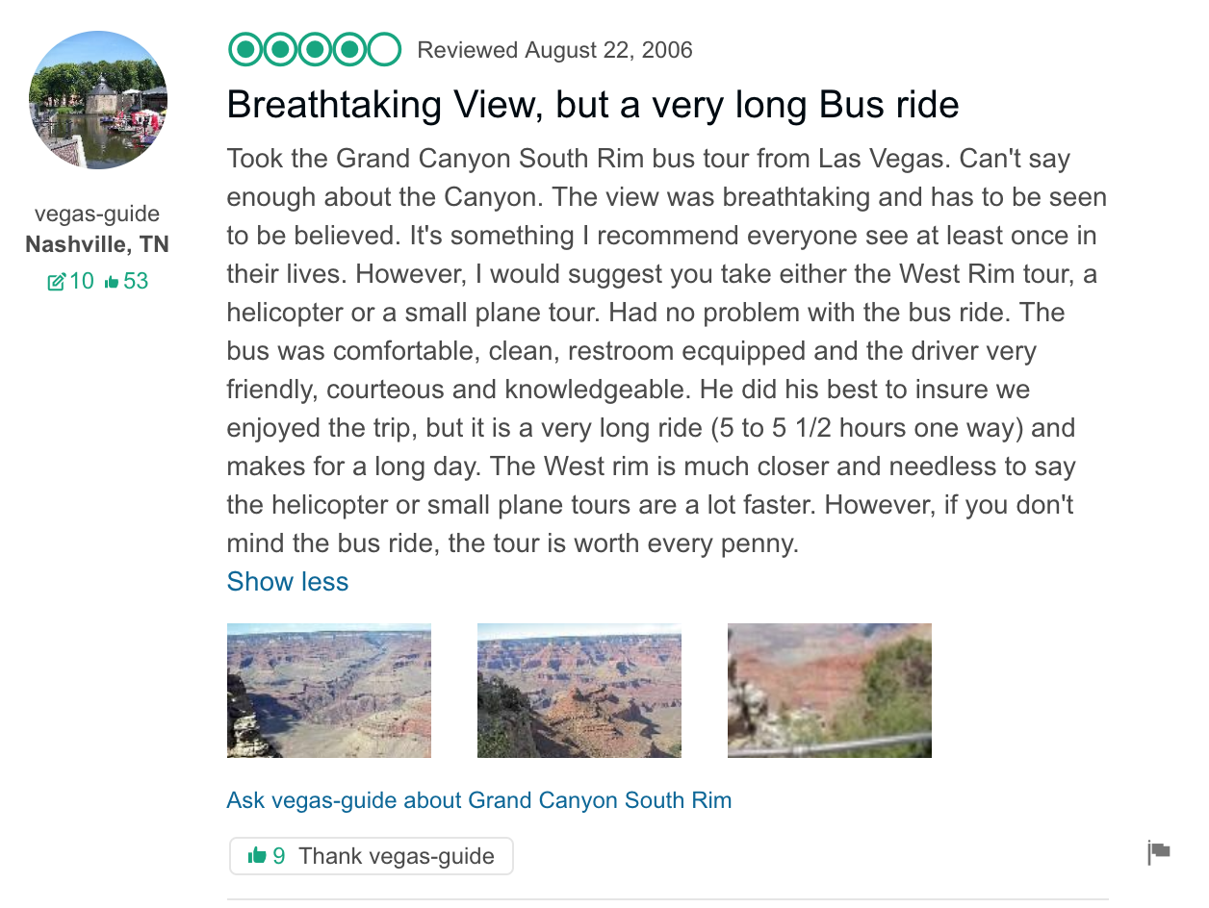
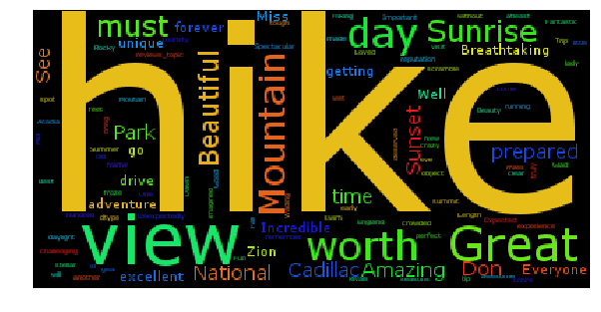
Word Cloud
Hiking!!!!!!

Slide 6
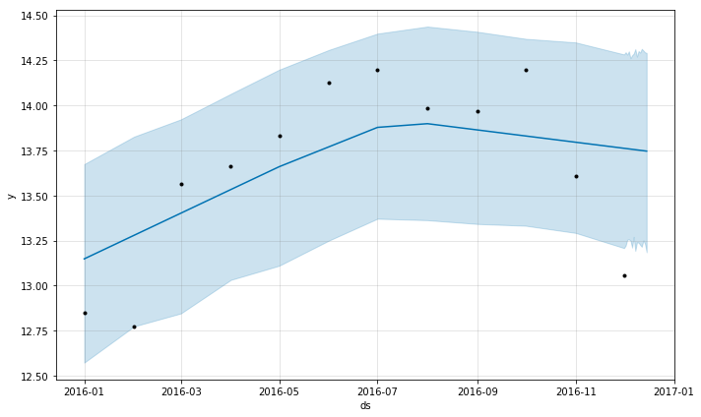
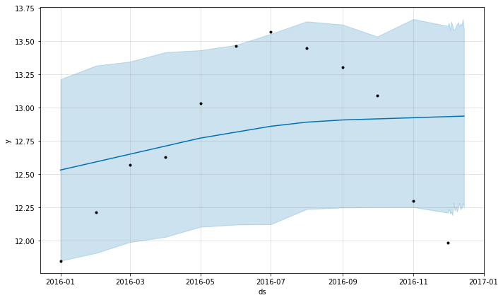
Time Series
Yosemite National Park
Great Smoky Mountain National Park

Slide 7
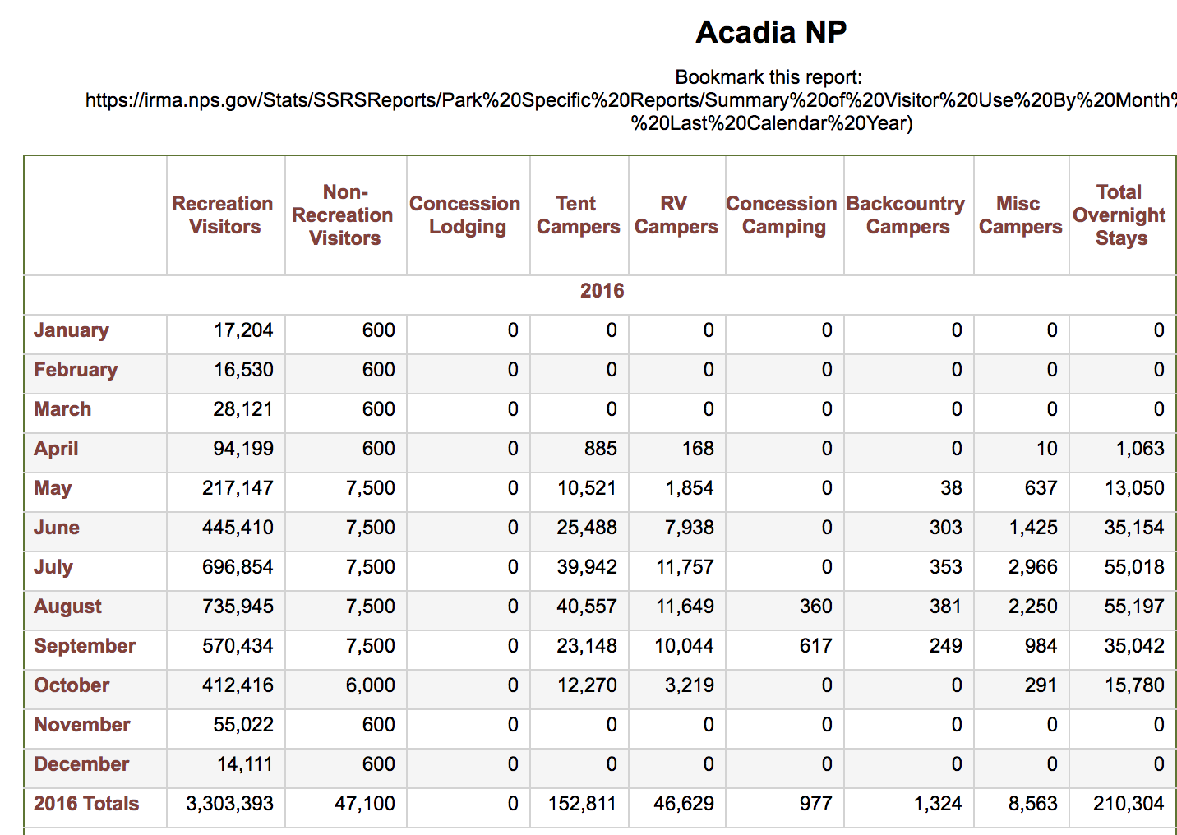
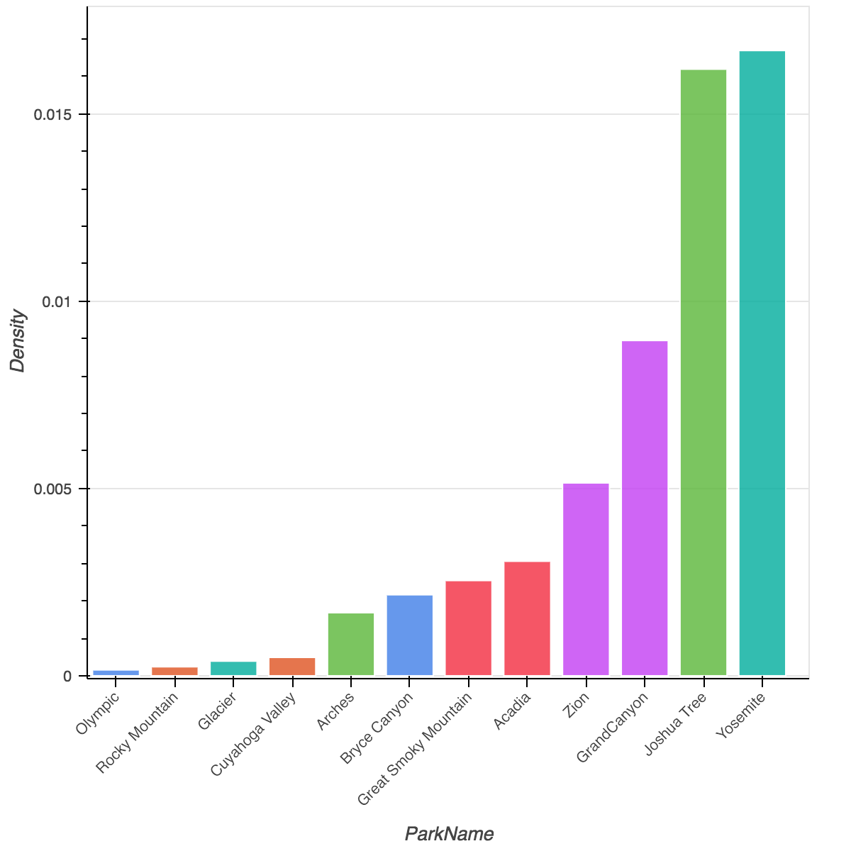
Density of the camping people

Slide 8
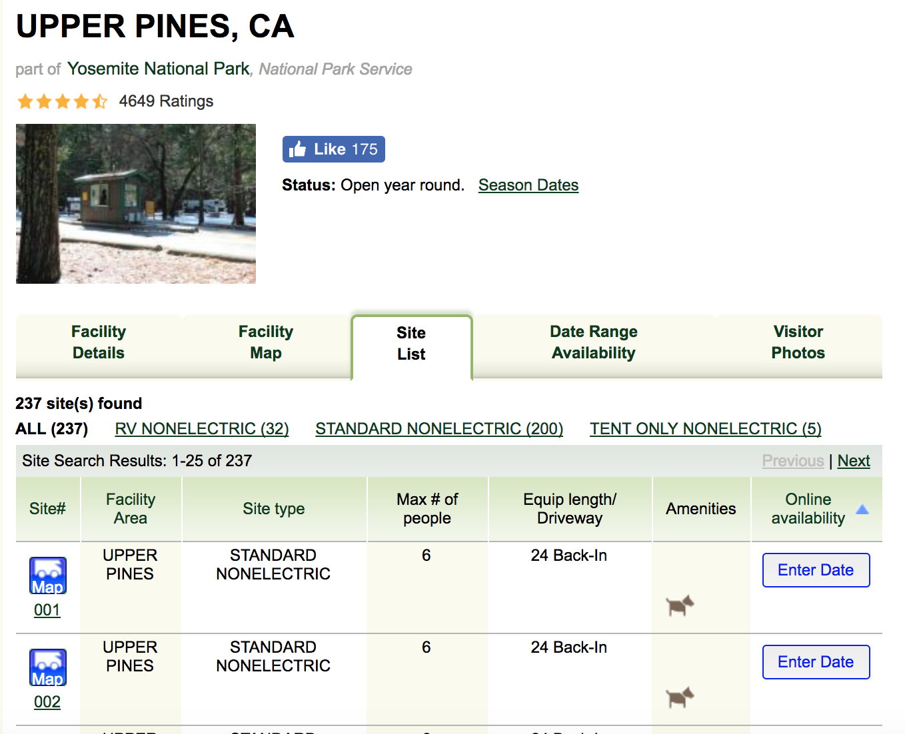
Accommodation for campers

Slide 9
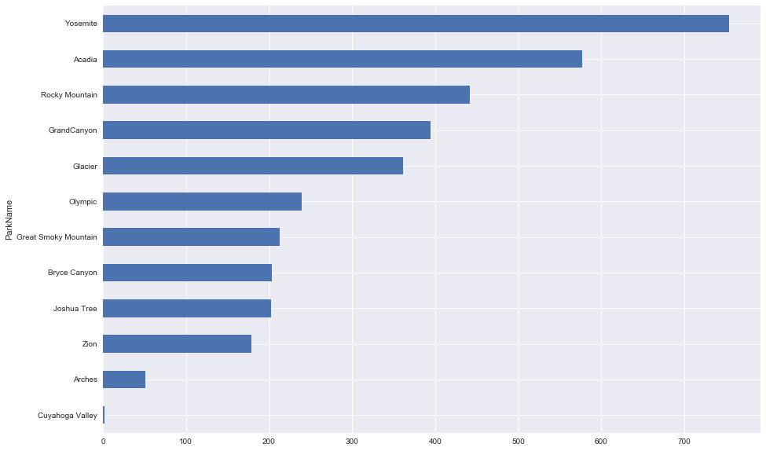
Accommodation for campers

Slide 10
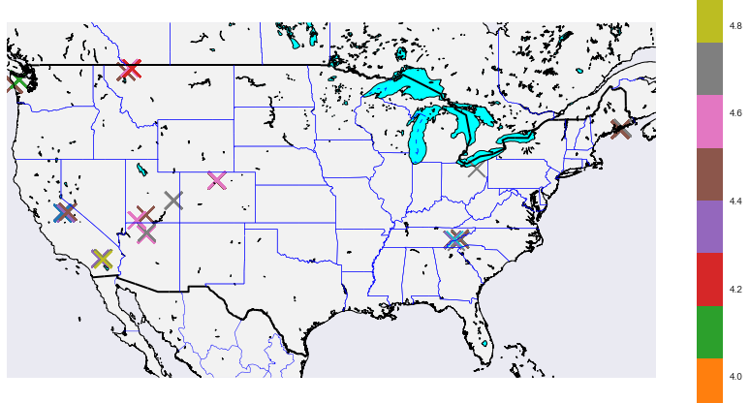
Map
Map based on stars

Slide 11
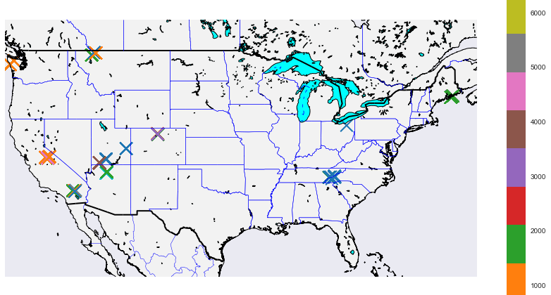
Map
Map based on reviews

Slide 12
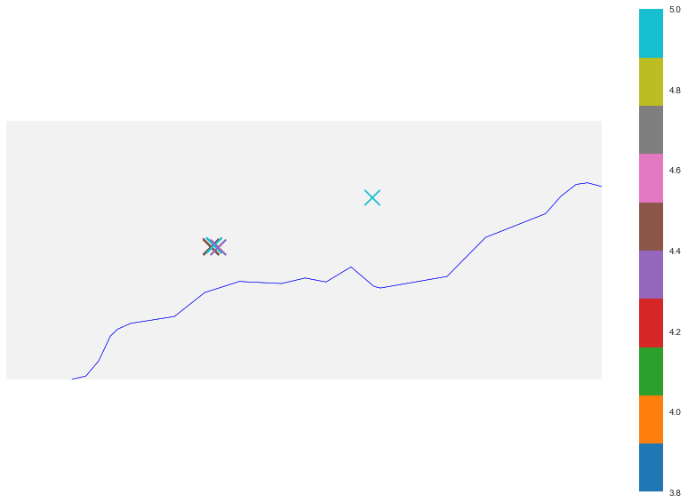
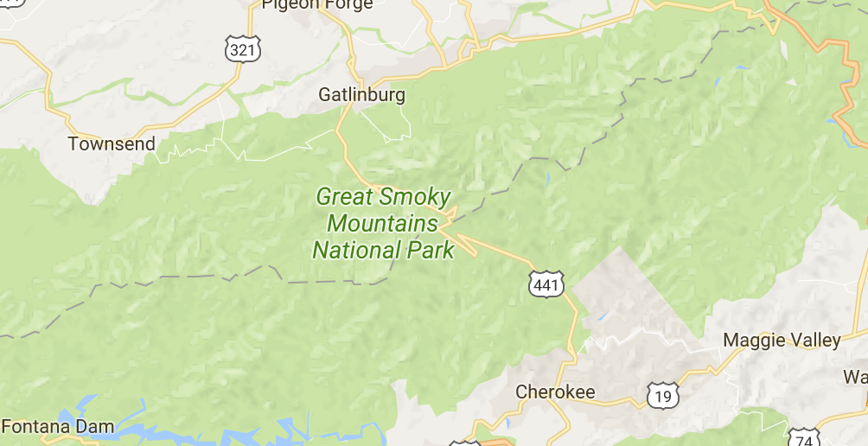
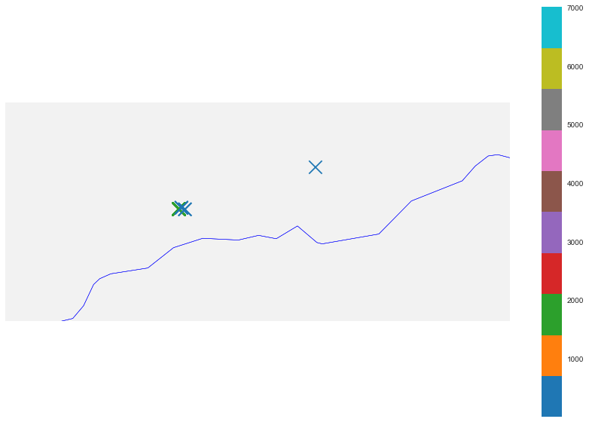
Great Smoky Mountain Map
Stars
Reviews

Slide 13
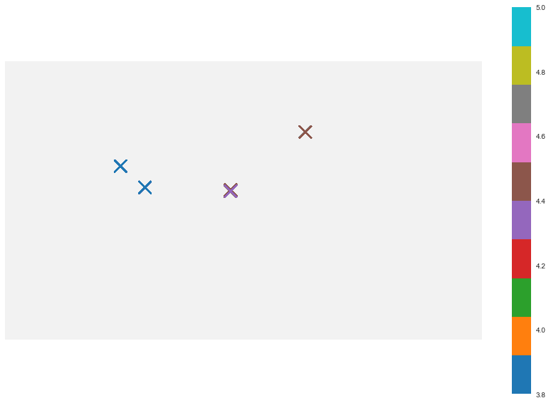
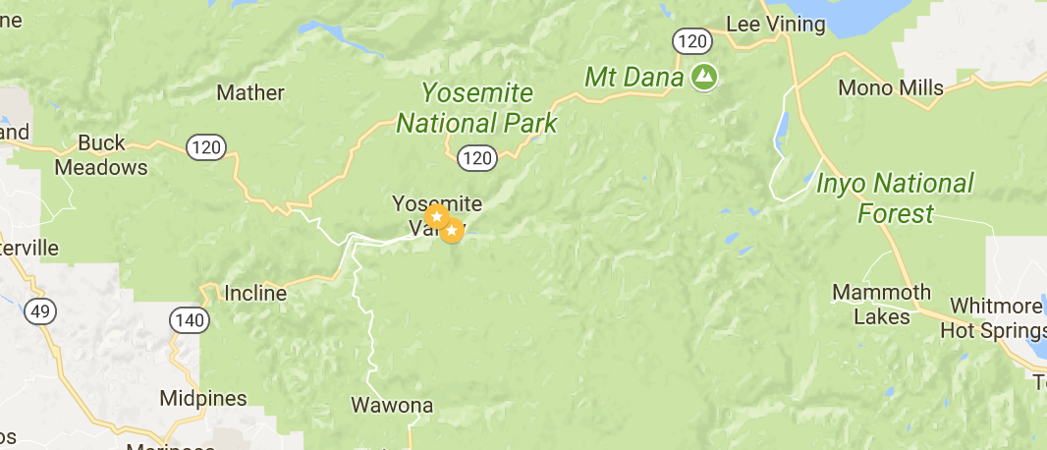
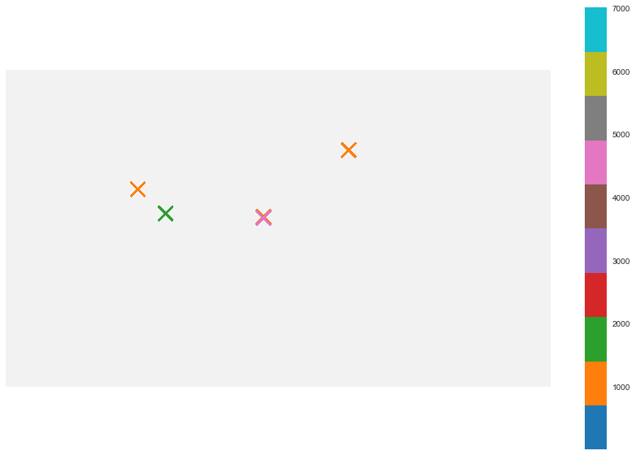
Yosemite Map
Stars
Reviews

Slide 14
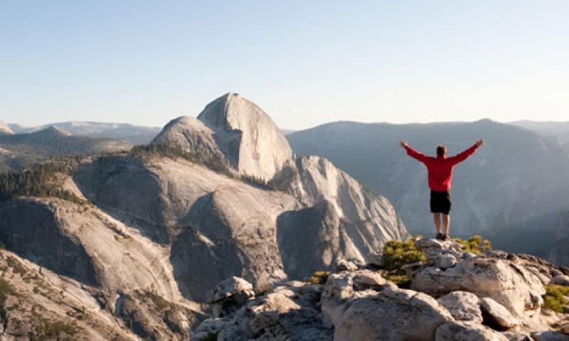
Conclusion
Choose off season to visit national park avoid summer and fall
Make camping reservation earlier in some National Parks. Exp. Joshua Tree National Park, Zion National Park

